Slide 1

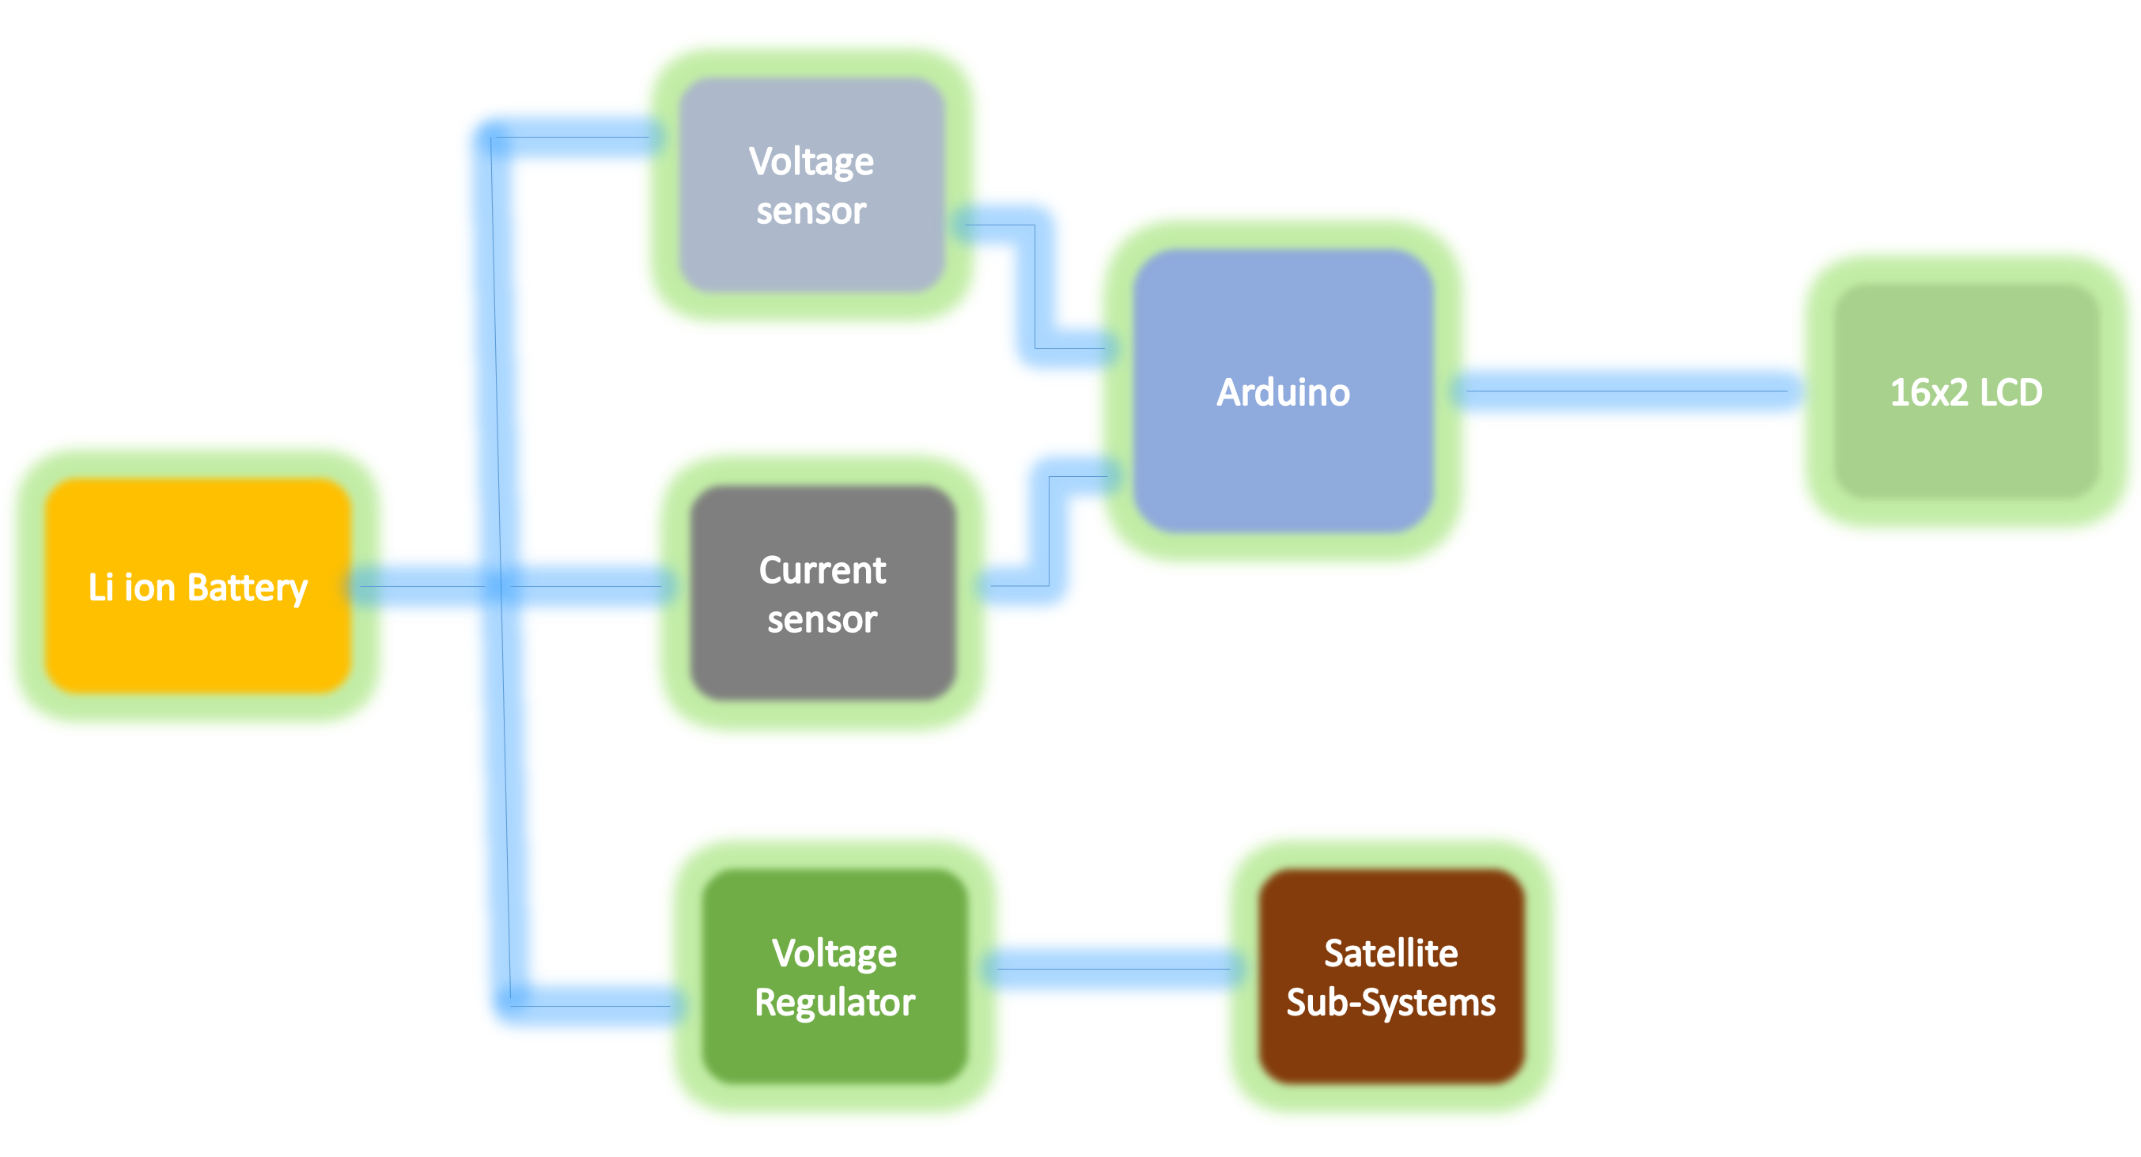
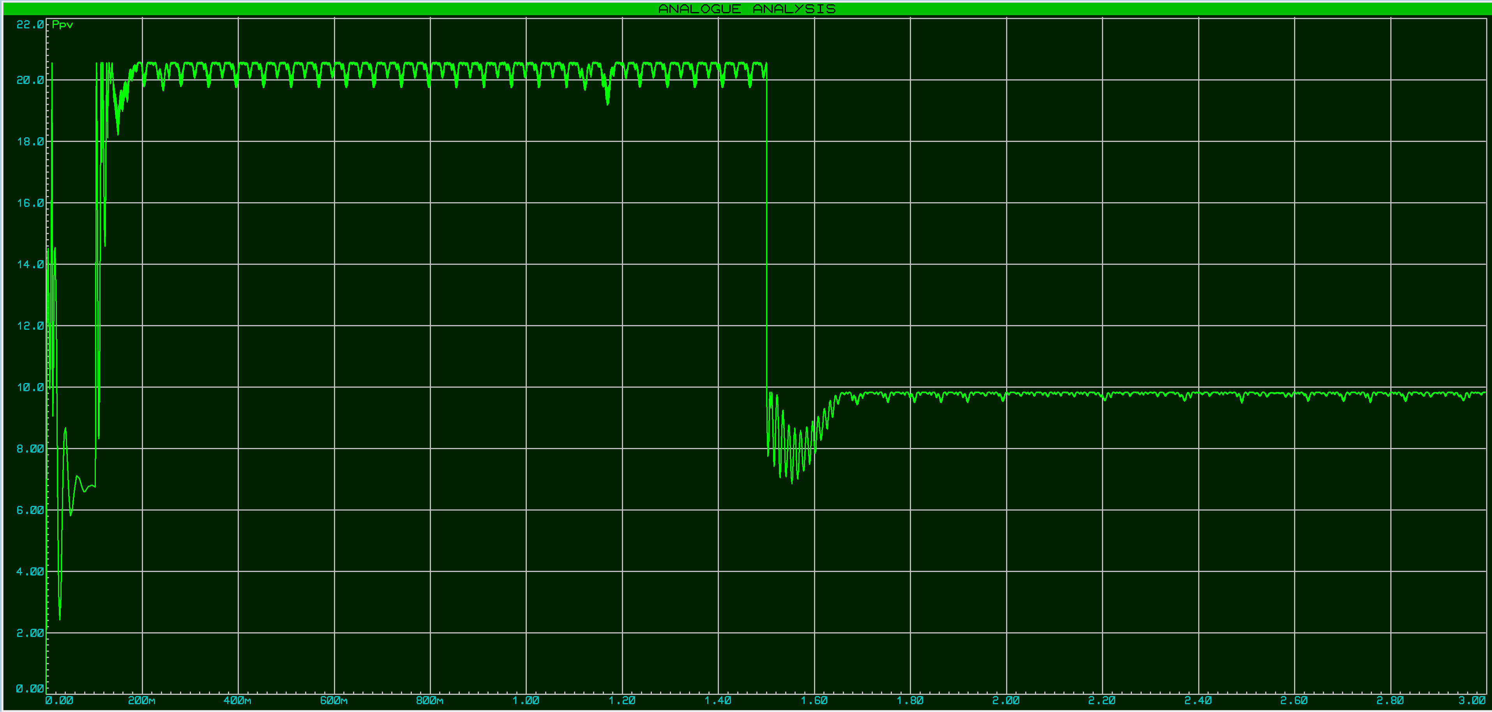
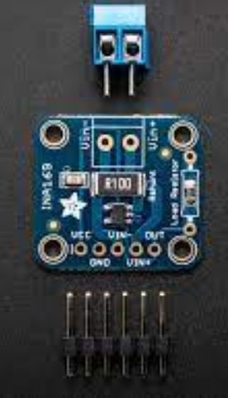
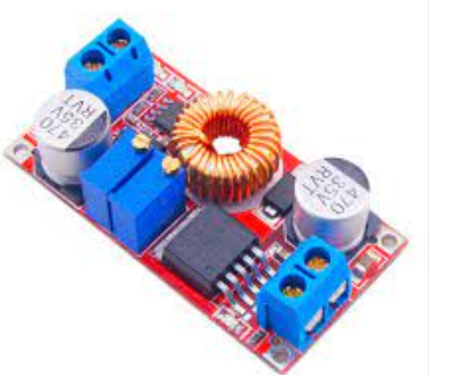
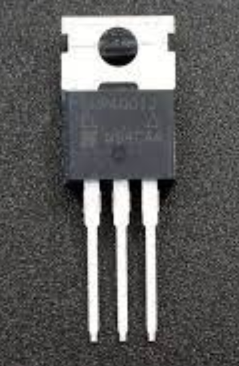
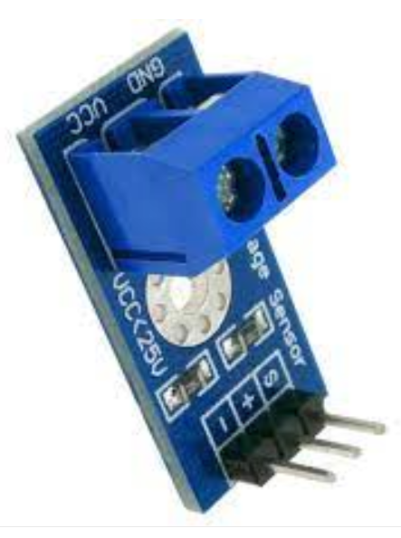
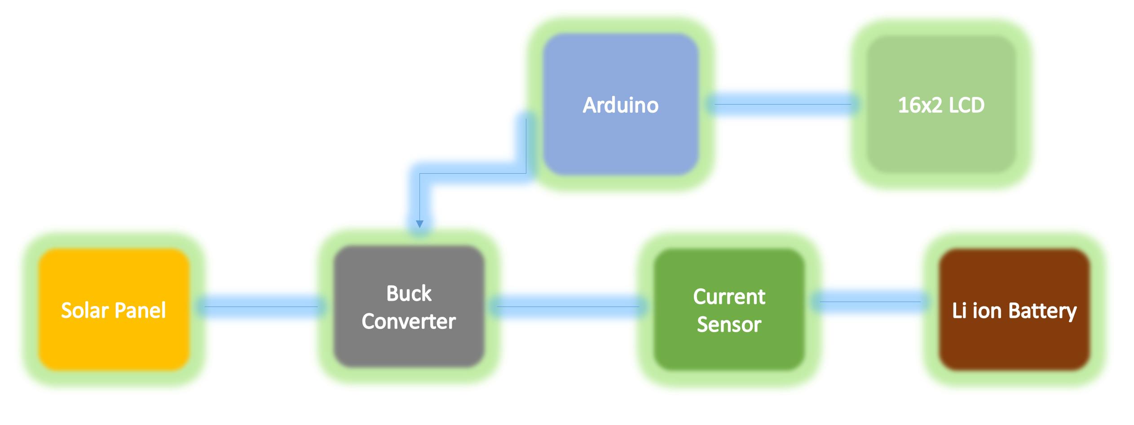
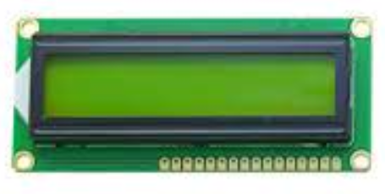
BATTERY MANAGEMENT SYSTEM FOR LOW EARTH ORBIT SATELLITES
ABSTRACT
Satellites need a secondary source to power up when they are in eclipse. We use batteries for that purpose. My goal is to use efficient charging discharging algorithms to increase the battery life.
OBJECTIVE
Battery power management is a critical area for satellite subsystems. Algorithms are being developed to ensure maximum life of battery’s installed on satellites. This project aims to develop a cost effective and simple battery management system for LEO satellites.
SIMULATION
METHODOLOGY
Design of Solar Charge controller by using Modified INC algorithm to extract maximum power from PV module.
CC CV Buck converter is used to charge the battery with charging and discharging algorithms.
Battery bank provide power to satellite sub-systems in eclipse.
CONCLUSION
This project serves to increase battery life of Li ion batteries by using efficient charging discharging algorithms as it is not possible to replace batteries and do maintenance in space.
COMPONENTS USED
BLOCK DIAGRAM
INA 169 CURRENT SENSOR
XL 4015 BUCK CONVERTER
IRFP 250 MOSFET
B25 VOLTAGE SENSOR
16X2 LCD DISPLAY
Designed By: Muhammad Osama Nusrat ADVISOR : HABEEL AHMAD CO-ADVISOR: MANSOOR ASIF

